Slide 1
Melanoma Spatial Analysis
6-17

Slide 2
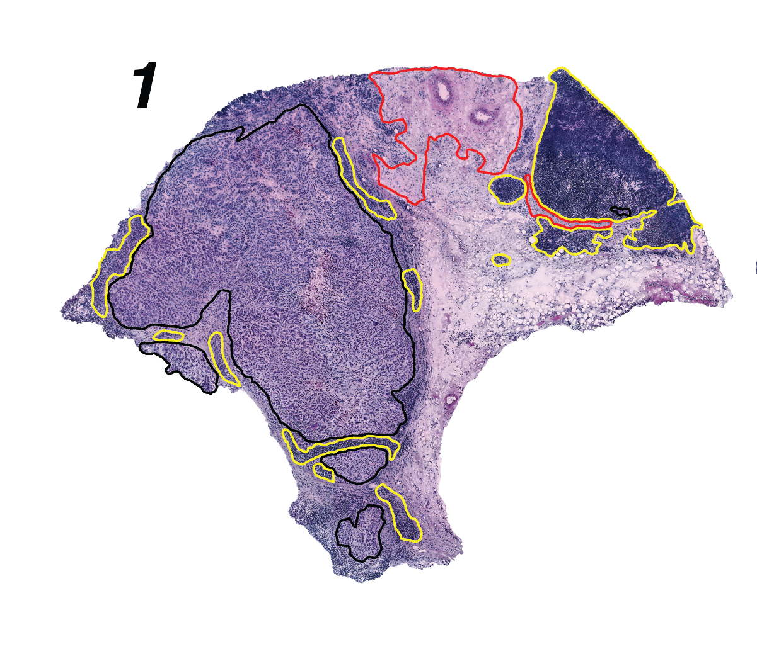
Histological annotation
Black = Tumor
Red = Stroma
Yellow = Lymphoid
Two replicates
Sample 1.1
Sample 1.2

Slide 3
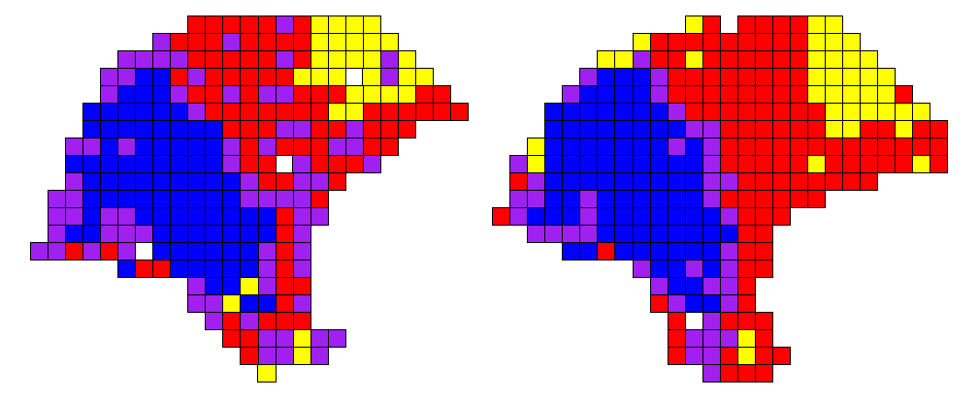
Mclust

Slide 4
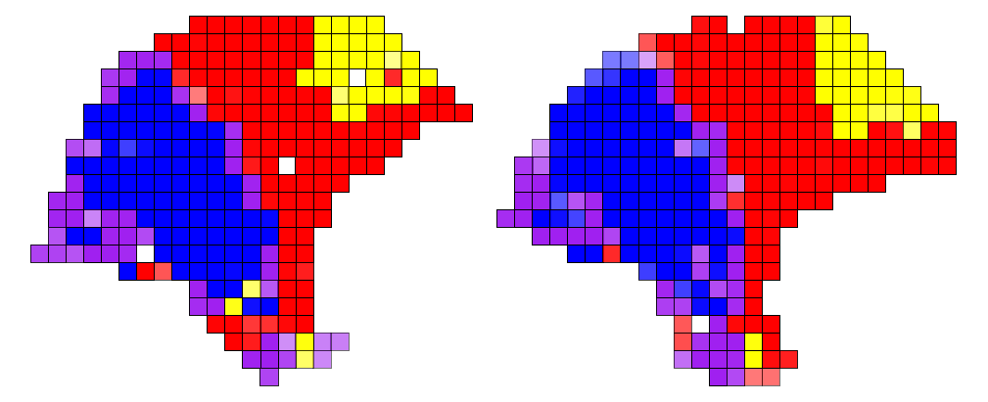
t-distributed spatial clustering

Slide 5
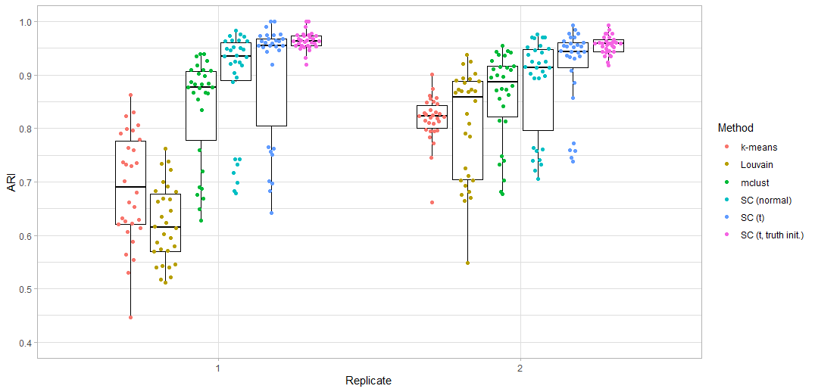
Clustering Simulation

Slide 6
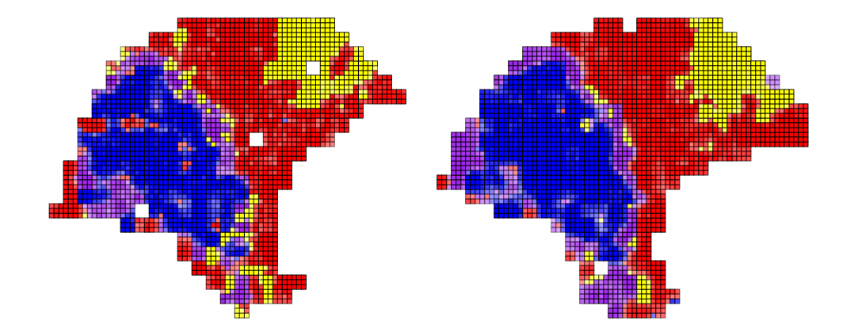
t-distributed spatial deconvolution, c = 0.003

Slide 7
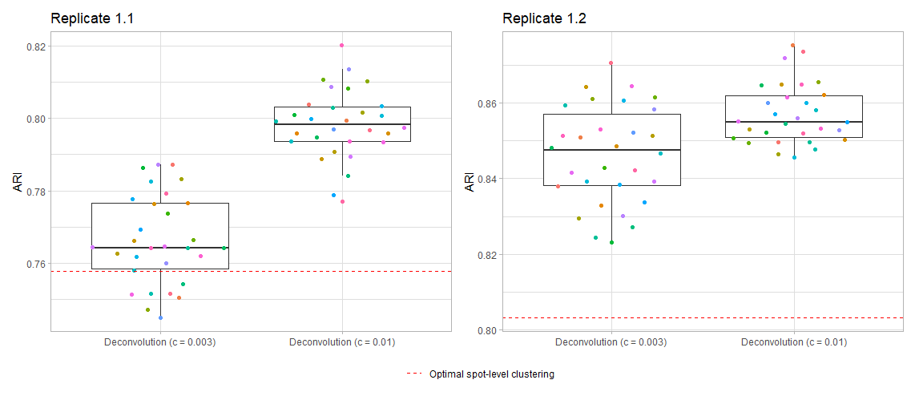
Deconvolution simulation ARI

Slide 8
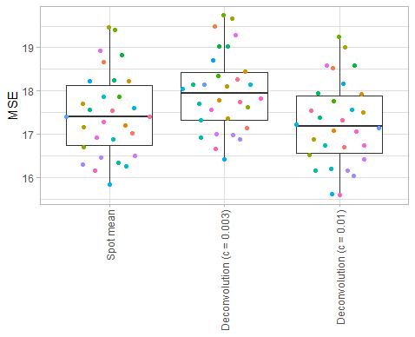
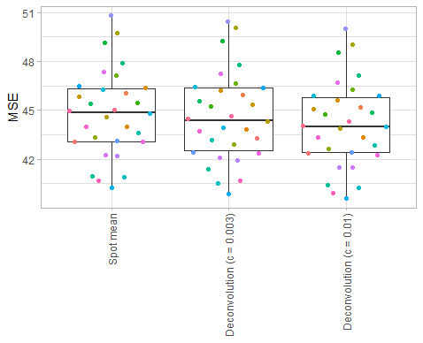
Deconvolution simulation MSE
Replicate 1.1
Replicate 1.2

Slide 9
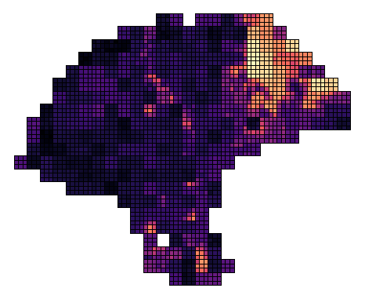
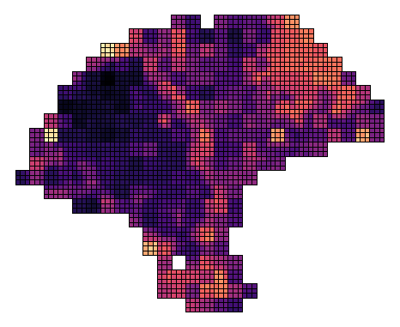
Predicted gene expression
B cell
T cell

Slide 10
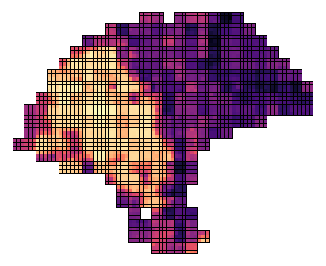
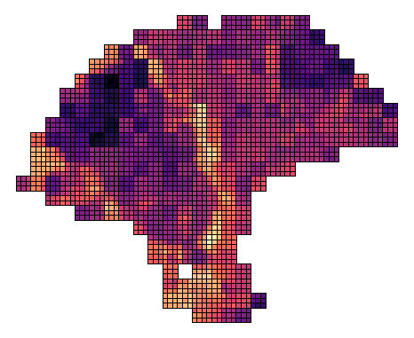
Predicted gene expression
Melanoma
Macrophage

Slide 11
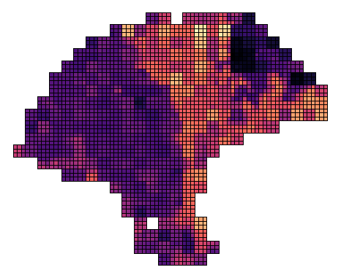
Predicted gene expression
CAF

Slide 12
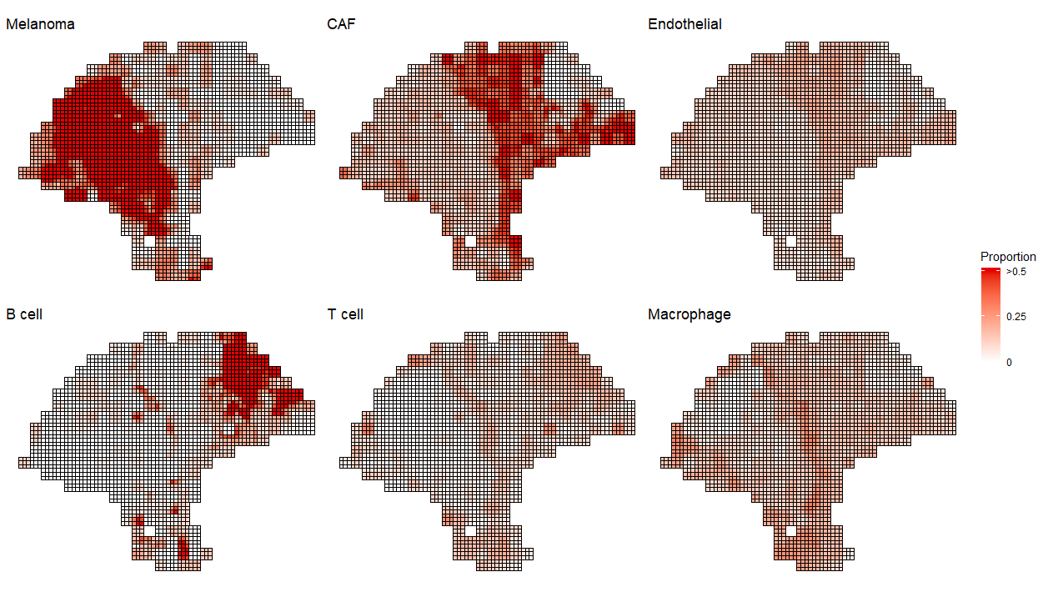

Slide 13
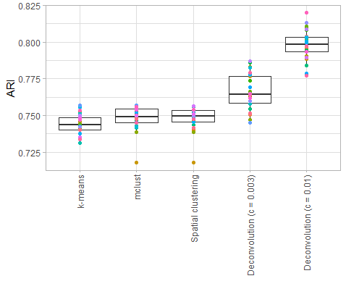
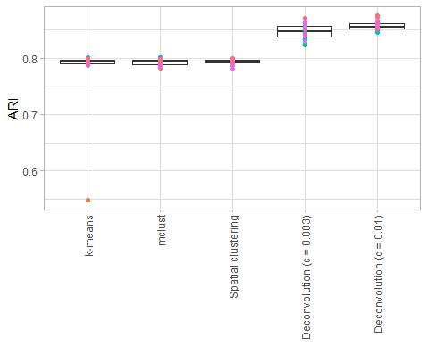
Deconvolution simulation ARI
Replicate 1.1
Replicate 1.2

Slide 14
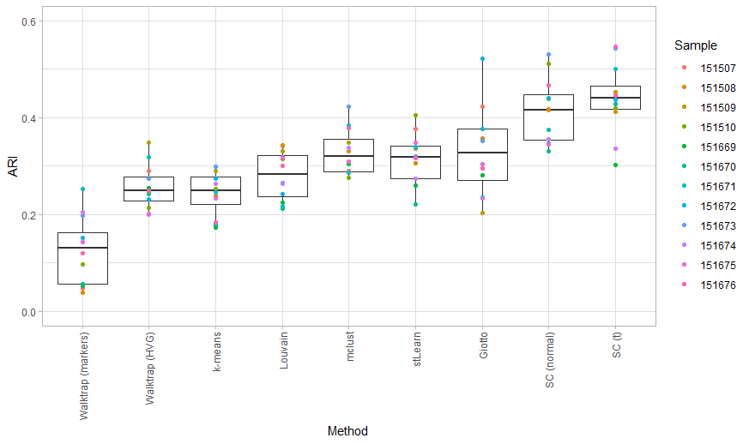
DLPFC (Fig 2)

Slide 15
Appendix

Slide 16

t-distributed spatial deconvolution, c = 0.010

Slide 17
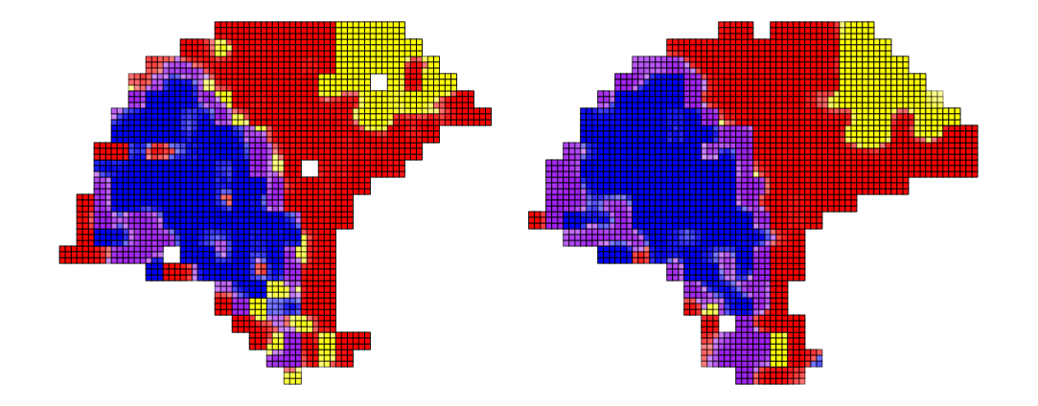
t-distributed spatial deconvolution, c = 0.020

Slide 18
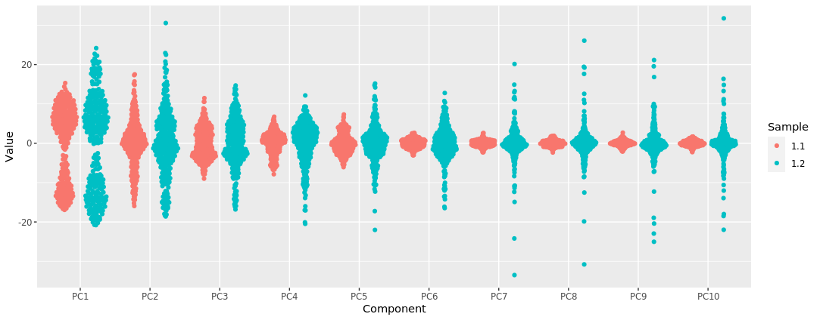
Distribution of principal components

Slide 19
Deconvolution simulation MSE
Replicate 1.1
Replicate 1.2

Slide 20
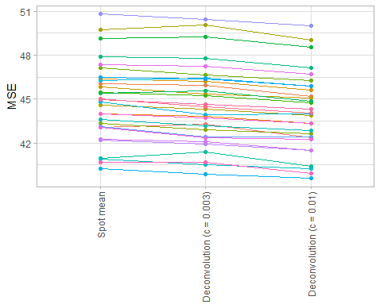
Deconvolution simulation MSE
Replicate 1.1
Replicate 1.2

